Slide 1

CFESA Cares Mission Statement:
Providing support and resources to inspire and educate those servicing commercial food equipment.

Slide 2
CFESA invites eligible applicants to compete for scholarships that will provide education opportunities to pursue a career in the commercial food equipment service industry.
The scholarships will include $2500 to use towards tuition, fees and educational materials, tools, as well as a mentoring session with a leader within CFESA, and will be highlighted throughout CFESA’s social media channels.
In addition to the $2,500 Scholarship through CFESA Cares, there is now a TOOL BONUS provided by AllPoints. It is worth a value of $1,500 in Klein tools, and the scholarship winner will get to personally select from the All Points inventory the Klein tools they would like

Slide 3


Slide 4
Who is CFESA?
The commercial Food Equipment Service Association (CFESA) is the official trade association for professional food service agents.
Founded in 1963, CFESA sets The Standards for Service Excellence.
A trade association comprised of independent service companies who employ certified service technicians.
CFESA provides
  Hands on training courses
  Certification testing
  Industry networking
  Training materials

Slide 5

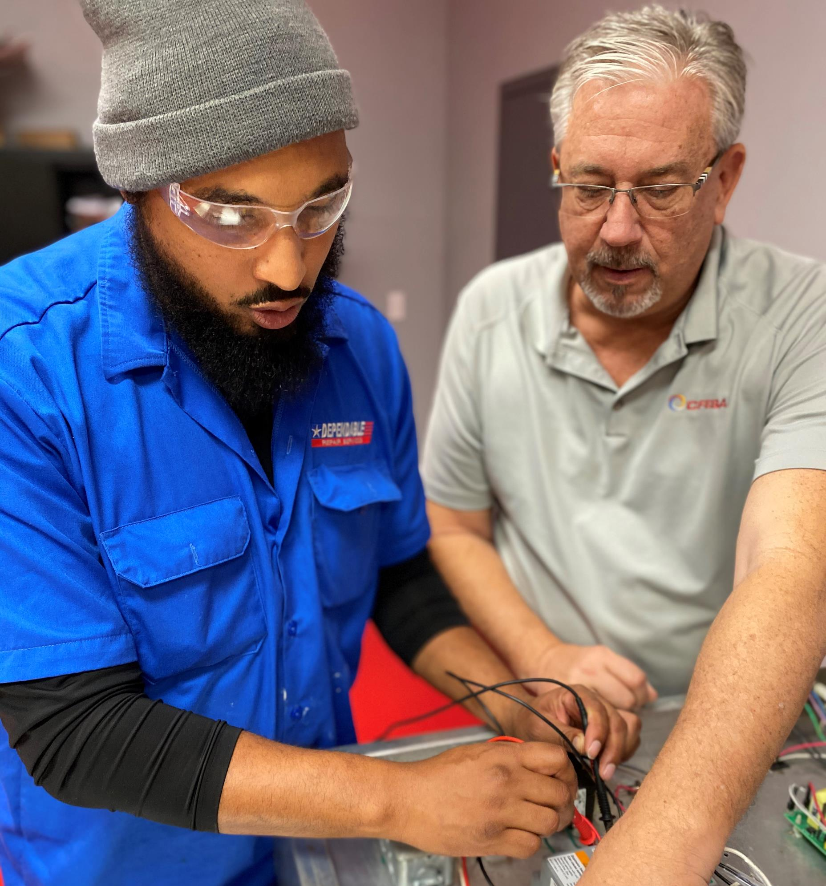
Do you like to problem solve? Are you computer/tech savvy? Are you a fast learner? Do you work well independently? Do you have a mechanical background? Can you weld?

Slide 6
Benefits of the Industry
Paid/on the job training
Company service vehicle
Full benefits
Overtime opportunities
No college degree necessary
Career advancement
Job security
Food Equipment Service Companies are everywhere!

Slide 7
Do I qualify for the scholarship?
Applicants must be 17 years of age or older to apply
Applicants must have obtained or currently working on obtaining a high school diploma or equivalent.
Applicants should be employed in the industry, or interested in pursuing a career as a commercial food service technician.
Characteristics we’re looking for:
Highly motivated
Customer Service Driven
Forward thinking self starter
Desire for learning and growth
Displays communication skills
Exhibits initiative and leadership qualities
Service oriented through outside activities and interests

Slide 8
How to Apply
Simply submit your application via the following link:
https://cfesa.com/cfesa-cares-scholarship-application/
Winners will be contacted by CFESA
In the meantime, follow our social media accounts to find out about industry happenings!

